Slide 1
Predicting film-director ratings
Joshua Banks Mailman

Slide 2
Questions investigated
Characterizing response to film directors
The investor, sponsor, or granting agency that funds film directors may be interested in…
• Besides profit margins they may be interested in alternative gauges of success of a movie
• Crowd-sourced critical response to the films of prolific acclaimed directors are a valuable resource to exploit to address this.
Predicting the ratings of their films
Based on data freely available to the general public, it may be possible to a build predictive models tailored to various film directors of the past.
• Such types of models can also be applied to directors that are still active.
• Most of the film directors examined are still active today.
More info on how to use this template at www.slidescarnival.com/help-use-presentation-template
This template is free to use under Creative Commons Attribution license. You can keep the Credits slide or mention SlidesCarnival and other resources used in a slide footer.

Slide 3
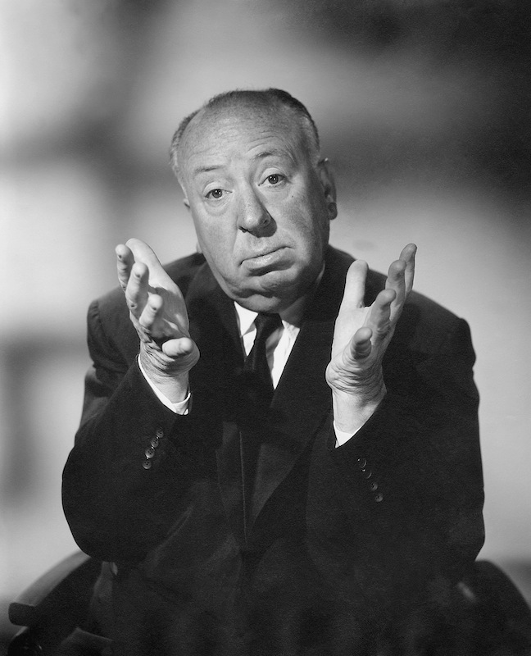
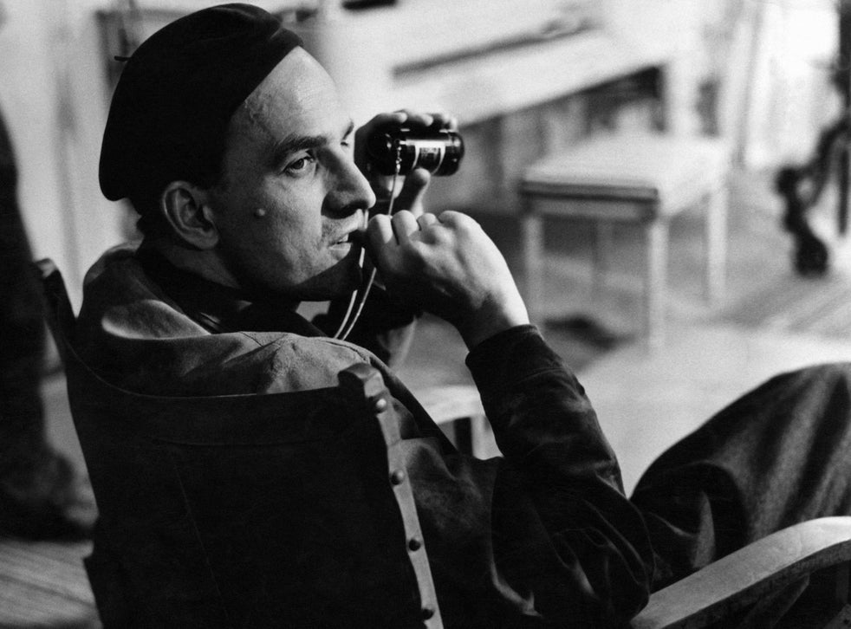
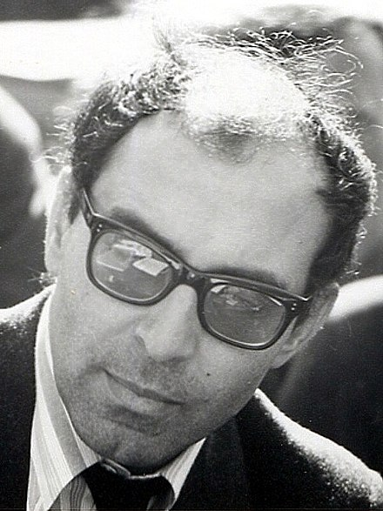
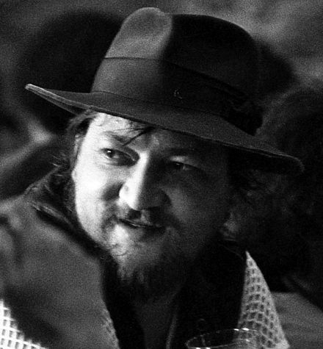
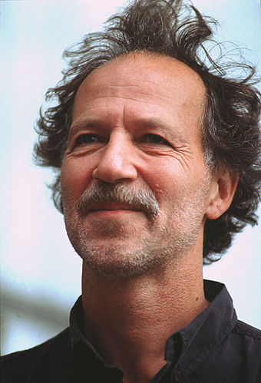
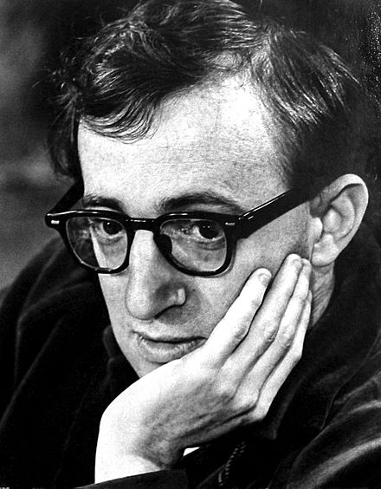
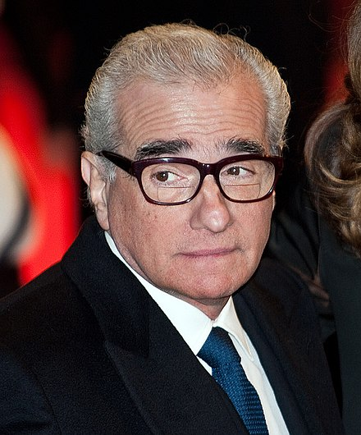
Who?
Seven acclaimed directors who are prolific
Alfred
Hitchcock
Ingmar Bergman
Jean-Luc Godard
Rainer Fassbinder
Werner Herzog
Woody Allen
Martin Scorsese

Slide 4
Source
IMDB (Internet Movie Database
• A nested web-scraping algorithm was required, since IMDB lists all of a director’s films on one page, but includes cast members and other info on a separate page dedicated to each film
• To improve on the worldwide gross box office returns data, www.the-numbers.com, was also scraped and joined, but this data was ultimately discarded for being incomplete

Slide 5
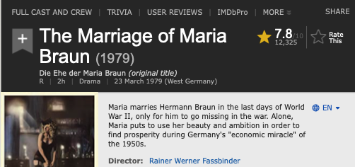
Target variable
Viewers’ Ratings
(scale from 1 to 10)

Slide 6
Target variable
Viewers’ Ratings
Features examined
continuous
Year released
Duration (in minutes)
Rating count (total number of times the film was rated on IMDB)
Budget
categorical
TV series vs. theatrical release
Documentary or not
Cinematographer
Cast members

Slide 7
9,000
Cleaned and Filtered
100%
7 directors x ~50 films each
x 15 actors & 10 other features
>
data points
As follows:
• Exclude actors appearing in < 3 films & one-off cinematographers
• Exclude films < 60 minutes
• Exclude films with crucial missing data and obvious outliers
• Exclude collinear features and those too often missing

Slide 8
Patterns in the data
Heatmap sorted by correlation to the target variable
rating count
rating count
rating count
year
budget
budget
year
duration
budget
Rating
Rating
Rating
Hitchcock
Allen
Herzog
Ingmar Bergman
Jean-Luc Godard
Rainer Fassbinder
Martin Scorsese

Slide 9
Patterns in the data
Alfred Hitchcock
Multicollinearity as expected between features and proxies for them, such as rating and metacritic score, and runtime and duration
Shapes of correlation
rating count
year
Rating
rating count
duration
budget
duration

Slide 10
To predict ratings:
Linear Regression
with train-test split to enable cross-validation
continuous features
Year released
Duration (in minutes)
Rating count (total number of times the film was rated on IMDB)
categorical features
TV series vs. theatrical release
Documentary or not
Cinematographer (excluding those who worked the least number of times with that director)
Cast members (if appearing in > 3 films)

Slide 11
Alfred Hitchcock and other directors, use a particular cinematographer during a particular phase of their career
Three of Hitchcock’s cinematographers
Jack E. Cox
(1920-30s)
Therefore cinematographer somewhat serves as a proxy for the time variable in years
Bernard Knowles
(late 1930s)
Robert Burks
(1950s-60s)

Slide 12
Linear regression models
 | A | B | C
Yellow | 10 | 20 | 7
Blue | 30 | 15 | 10
Orange | 5 | 24 | 16
R² values
on test-set after training
0.21

Slide 13
How Hitchcock’s ratings rise
Smoothed moving average (lowess)
Hitchcock movies tend to be rated higher to the extent they are released later in his career and are rated by many
Feature
engineering
Regression on log of ratings count
Bring the attention of your audience over a key concept using icons or illustrations

Slide 14
Linear regression models
 | A | B | C
Yellow | 10 | 20 | 7
Blue | 30 | 15 | 10
Orange | 5 | 24 | 16
R² values on test-set after training
Allen
0.21
fewer features
more
Feature
engineering
Hitchcock
year, duration, rating count, log(year), log(rating count)
Coefficients:
-50.668, -0.198, 0.101, 50.892, 0.560
Hitchcock

Slide 15
Opposite trends
Hitchcock
Allen
R² on test set
R² on test set
Bring the attention of your audience over a key concept using icons or illustrations

Slide 16
Further investigations
Regularization to improve prediction
• Using polynomials apply Lasso or Ridge regression, with K-fold cross validation to all the film directors to exploit every possible feature
• Add logarithmic features in the Lasso/Ridge regression
• Examine quantile-quantile plots
Develop explanation
• Examine residuals in tandem with domain knowledge to discover and explain interactions between features, such as:
• budget & rating:
inversely correlated?
• duration ~ budget ?
• more visualizations

Slide 17
Further investigations
Alfred Hitchcock
Shapes of correlation
rating count
year
Rating
rating count
duration
budget
duration

Slide 18
Hitchcock’s movies increased in duration
Their ratings have a sweet spot just past the middle
rating

Slide 19
Further investigations
Regularization to improve prediction
• Using polynomials apply Lasso or Ridge regression, with K-fold cross validation to all the film directors,.
• Add logarithmic features in the Lasso/Ridge regression
• Examine quantile-quantile plots
Develop explanation
• Examine residuals in tandem with domain knowledge to discover and explain interactions between features, such as:
• budget & rating: inversely
correlated?
• duration ~ budget ?
and…

Slide 20

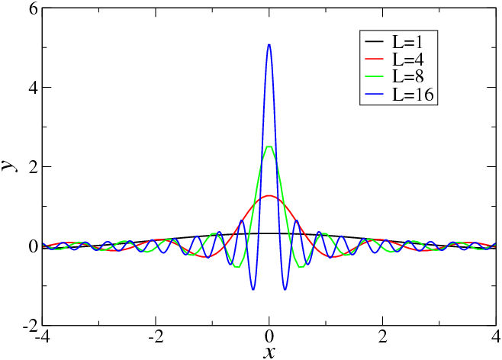
Feature engineering
100%
Model the spike in ratings count, using the Dirac Delta function (”impulse” function)

Slide 21
Predicting film-director ratings
Joshua Banks Mailman
joshuabanksmailman@gmail.com
Thanks!

Slide 31
Linear regression results
Feature sets | Hitchcock | Bergman | Godard | Allen | Allen* | Fassbinder | Herzog | Scorsese
All (continuous & categories) | -7.88 | -1.41 | -0.09 | -14.26 | 0.21 | -1.26 | -0.07 | -0.41
Continuous only | 0.33 | 0.15 | 0.26 | 0.51 | 0.4 | 0.27 | 0.07 | 0.17
Year | 0.47 | -0.15 | -0.11 | 0.24 | 0.04 | -0.08 | 0.04 | -0.18
Year & Ratings count | 0.44 | -0.1 | 0.11 | 0.51 | 0.46 | 0.21 | 0.06 | -0.19
Year & Duration only | 0.28 | 0.16 | 0.25 | 0.23 | -0.04 | -0.02 | 0.03 | 0.19
Year & Ratings count & their logs | 0.8 | 0.84 | 0.35 | 0.48 | 0.37 | 0.48 | 0.16 | -0.22
Year & log(rating count) | 0.68 | 0.8 | 0.34 | 0.36 | 0.45 | 0.12 | 0.11 | 0.25
Lasso CV w/ polynomials on all features | 0.41
Include budget but w/ smaller dataset |  |  |  |  |  |  |  | 0.69
Rr² values
on test-set after training
 | A | B | C
Yellow | 10 | 20 | 7
Blue | 30 | 15 | 10
Orange | 5 | 24 | 16

Slide 32
In two or three columns
Yellow
Is the color of gold, butter and ripe lemons. In the spectrum of visible light, yellow is found between green and orange.
Blue
Is the colour of the clear sky and the deep sea. It is located between violet and green on the optical spectrum.
Red
Is the color of blood, and because of this it has historically been associated with sacrifice, danger and courage.

Slide 33

Want big impact?
Use big image.

Slide 34
Use charts to explain your ideas
White
Gray
Black

Slide 35
And tables to compare data
 | A | B | C
Yellow | 10 | 20 | 7
Blue | 30 | 15 | 10
Orange | 5 | 24 | 16

Slide 36
Maps
our office

Slide 37
89,526,124
Whoa! That’s a big number, aren’t you proud?

Slide 38
Our process is easy
first
second
last

Slide 39
Let’s review some concepts
Yellow
Is the color of gold, butter and ripe lemons. In the spectrum of visible light, yellow is found between green and orange.
Blue
Is the colour of the clear sky and the deep sea. It is located between violet and green on the optical spectrum.
Red
Is the color of blood, and because of this it has historically been associated with sacrifice, danger and courage.
Yellow
Is the color of gold, butter and ripe lemons. In the spectrum of visible light, yellow is found between green and orange.
Blue
Is the colour of the clear sky and the deep sea. It is located between violet and green on the optical spectrum.
Red
Is the color of blood, and because of this it has historically been associated with sacrifice, danger and courage.

Slide 40
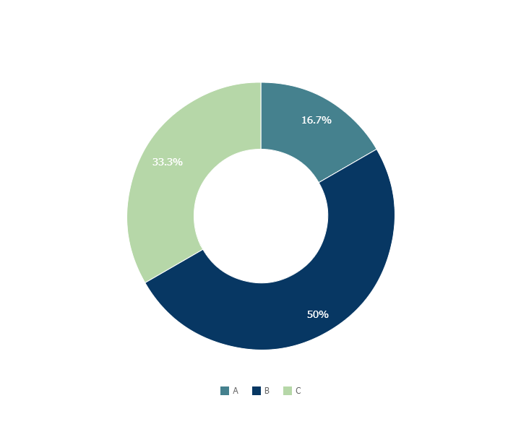
You can copy&paste graphs from Google Sheets

Slide 41

Mobile project
Show and explain your web, app or software projects using these gadget templates.

Slide 42

Tablet project
Show and explain your web, app or software projects using these gadget templates.

Slide 43

Desktop project
Show and explain your web, app or software projects using these gadget templates.

Slide 44
Thanks!
Any questions?
You can find me at
@username
user@mail.me

Slide 45
Credits
Special thanks to all the people who made and released these awesome resources for free:
Presentation template by SlidesCarnival
Photographs by Unsplash

Slide 46
Presentation design
This presentations uses the following typographies and colors:
Titles & Body copy: Montserrat
You can download the fonts on this page:
https://www.fontsquirrel.com/fonts/montserrat
Grey #454f5b
Light grey #738498
Neon green #c7f464
Aqua #4ecdc4
You don’t need to keep this slide in your presentation. It’s only here to serve you as a design guide if you need to create new slides or download the fonts to edit the presentation in PowerPoint®

Slide 47
SlidesCarnival icons are editable shapes.
This means that you can:
Resize them without losing quality.
Change fill color and opacity.
Change line color, width and style.
Isn’t that nice? :)
Examples:

Slide 48
Diagrams and infographics

Slide 49
Now you can use any emoji as an icon!
And of course it resizes without losing quality and you can change the color.
How? Follow Google instructions https://twitter.com/googledocs/status/730087240156643328
😉
✋👆👉👍👤👦👧👨👩👪💃🏃💑❤😂😉😋😒😭👶😸🐟🍒🍔💣📌📖🔨🎃🎈🎨🏈🏰🌏🔌🔑 and many more...

Slide 50
Linear regression models
 | A | B | C
Yellow | 10 | 20 | 7
Blue | 30 | 15 | 10
Orange | 5 | 24 | 16
R² values
on test-set after training
Allen
0.21
Feature
engineering
Hitchcock
year, duration, rating count, log(year), log(rating count)
Coefficients:
-50.668, -0.198, 0.101, 50.892, 0.560
Hitchcock

Slide 51

Free templates for all your presentation needs
For PowerPoint and Google Slides
100% free for personal or commercial use
Ready to use, professional and customizable
Blow your audience away with attractive visuals

